Slide 1







Tree.st / Appendix A - Team Formation and Innovation
Tree.st
Allow the new team to brainstorm and collaborate to discover an innovative solution
Use Tree.st to discover the right people across your organization and create a diverse and focused team, fast
Step 3: Collaborate
Step 2: Team Formation
“We have a problem, we need to find a solution, fast”
Step 1: Recognition
Step 4: Derive Value

Slide 2
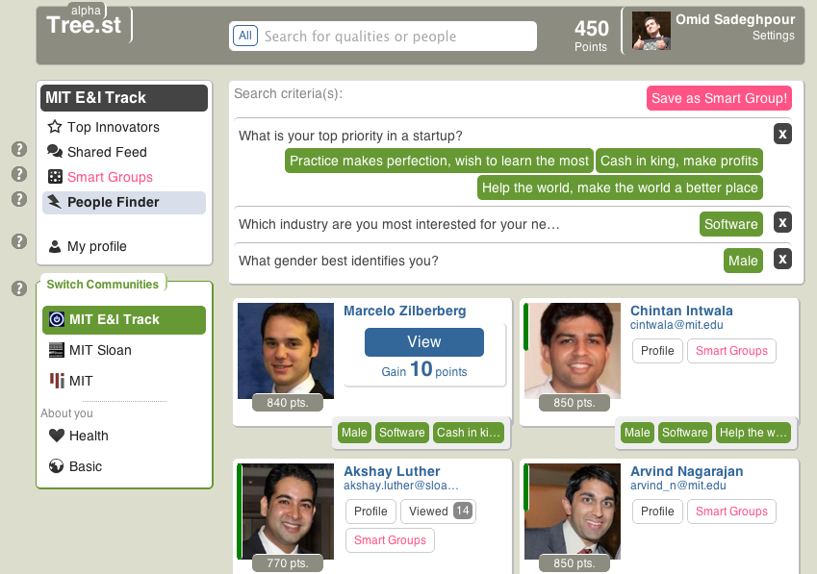
Tree.st / Appendix B – People Finder
Search
Demonstrates a search for a “male” entrepreneur interested in the “software” industry who wants to either “help the world,” “make cash,” or “just learn” about startups by practicing.
Gamification
In this community users “gain 10 points” for viewing one another, in another community users might have to “pay 10 points” to view one another.

Slide 3
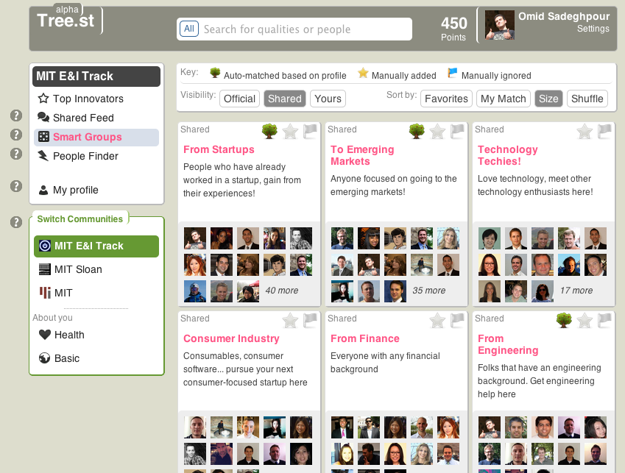
Tree.st / Appendix C – Smart Groups
Smart Groups – community members can create “smart” groups that add new and old members to the group based on how well a user matches the “smart” group’s search criteria. These “smart” groups are great for dynamic and transitory populations

